Slide 1
Dino Runner AI
COSC 5550 Final Project
Jacob Centner

Slide 2

Goals
Create an AI that will play better than a human
01
Learn more about ANNs (CNNs specifically)
02
Learn how to perform image processing
03
Become more familiar with TensorFlow and Keras
04
Notes:
Play better than me, ANNs/CNNs used in everything so I wanted to learn how to implement them, image processing interesting and useful tool to know, seen projects with TensorFlow before and wanted to get my feet wet

Slide 3
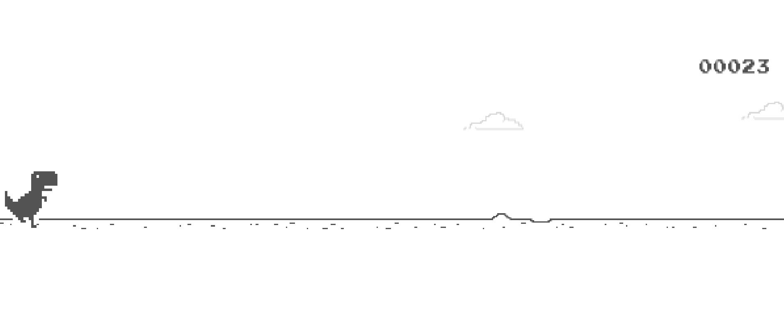
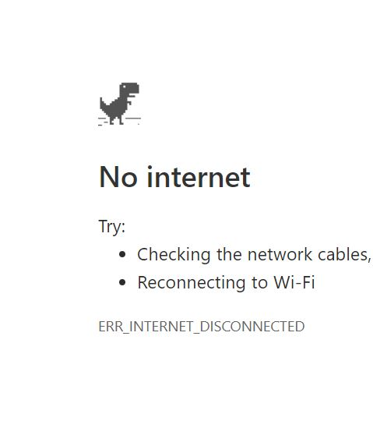
What is ChRome Dino?

Slide 4





Tools and Technology
Notes:
Used python in Jupyter Notebooks to implement. Tensorflow by Google, high performance deep learning library. Keras API makes it accessible. OpenCV for image processing.

Slide 5
Approach
Generate training data
1
Create and train the model
2
Apply model to game state to determine action
3
Notes:
Need labeled training set. Recorded me playing and my input, except when I failed. Broke into classification: jump or not. Not ideal approach, we’ll see how well it worked. Created and trained model with TF and Keras. Both creating and training properly took lots of research. Finally, use model to predict action based on current game state.

Slide 6
Anticipated Challenges
Performance
Learning Curve
Game mechanics
Notes:
Needed to process frames fast enough that the AI could react in time. Needed GPU to train model in reasonable time. Knew nothing of TF, Keras, OpenCV, and not great at python so steep learning curve. Game speeds up, night and day.

Slide 7
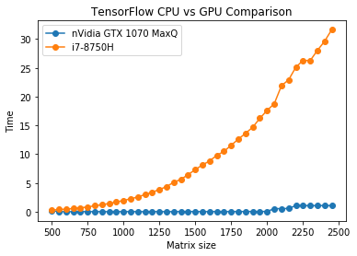
Notes:
Just a sidenote on CPU vs GPU application in deep learning. Taken with my comp.

Slide 8
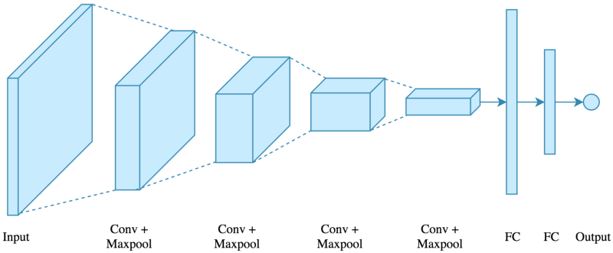
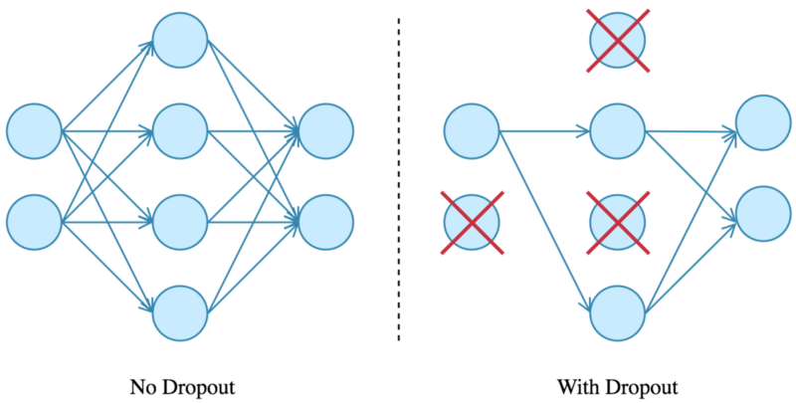
Convolutional Neural Net Design
Notes:
Refresher on CNN design. Convolution layers for feature extraction, followed by dense (fully connected) classification layers. Dropout used in my architecture to improve robustness.

Slide 9
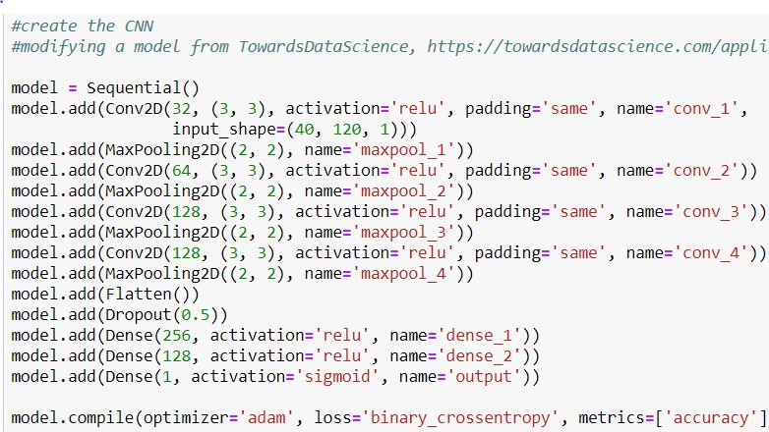
Notes:
My finished model. Took a long while to get here, is not what you will see in the next couple slides. This is Keras, greatly simplifies TF and spares you from breaking your brain on Tensors. Four convo layers, dropout, then fully connected. Single output: 1 for jump, 0 for not.

Slide 10
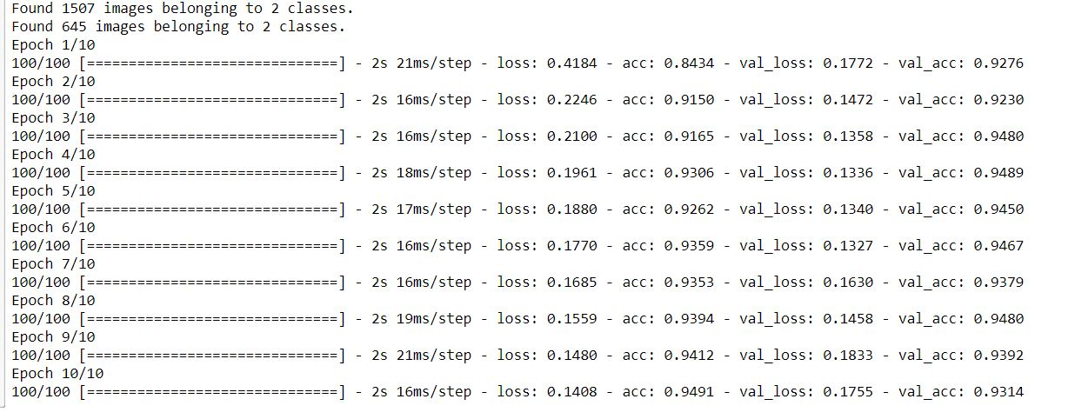
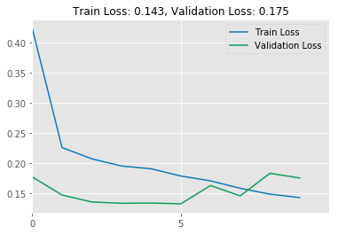
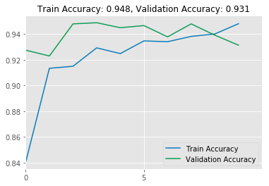
First Run
Notes:
Very small data set, test run. First success.

Slide 11
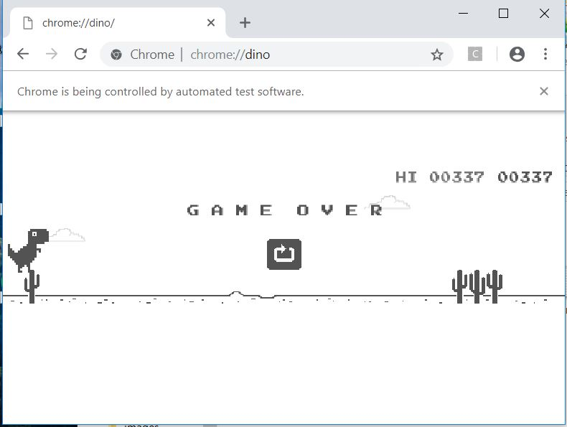

Slide 12
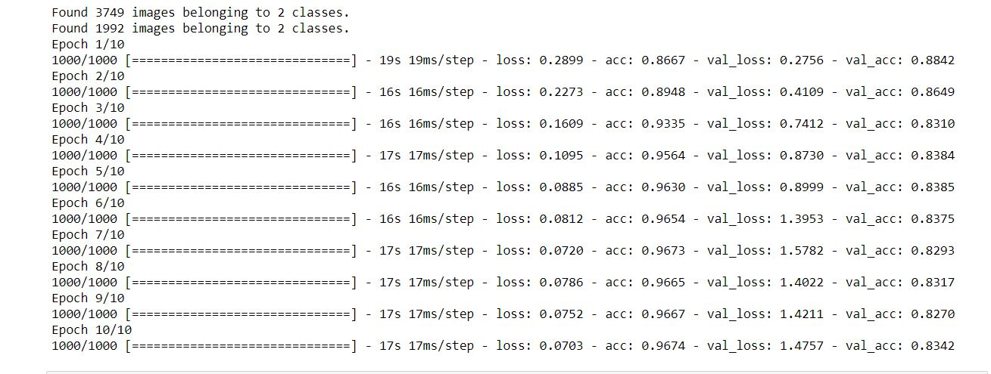
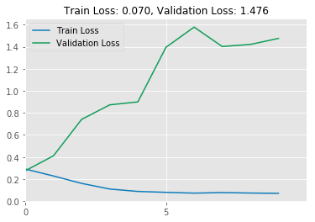
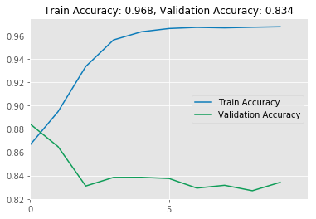
Overfitting Issues
Notes:
See after first epoch, val_loss increases. Overfit: too little data, training way too long, took a while to realize that.

Slide 13
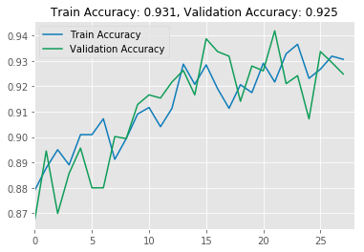
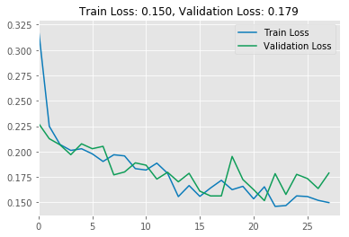
Much Later
Notes:
After many more adjustments, I ended up here. ~16000 training images used.

Slide 14
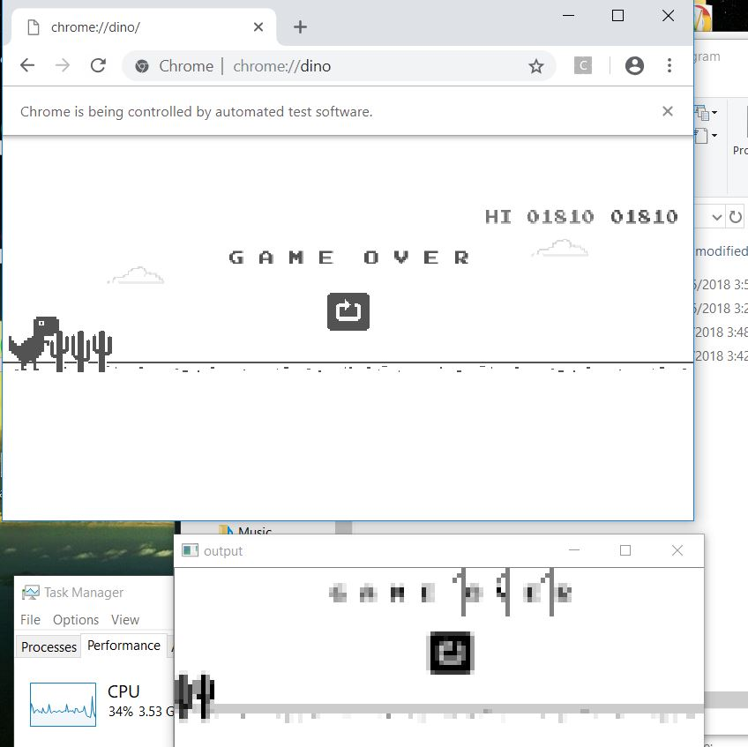
Success?
Learned a lot
OpenCV
TensorFlow & Keras
CNNs
Performance lacking
Cannot beat a good human
CPU limited and intensive
It does work though!

Slide 15
Future Improvements
More data!
Better data
Reinforcement Learning
Model Architecture
Even more data!
Notes:
Generate training data differently. RL a different approach instead of CNN, or in addition too. Want to explore that. Refine model architecture.

Slide 16
Credit
Applied Deep Learning with Keras (https://github.com/ardendertat/Applied-Deep-Learning-with-Keras/blob/master/notebooks/)
TowardsDataScience (https://towardsdatascience.com/applied-deep-learning-part-4-convolutional-neural-networks-584bc134c1e2)
Tianyi Pan (https://www.linkedin.com/pulse/part-1-applied-computer-vision-using-opencv-beat-wechat-tianyi-pan/)
Harrison@pythonprogramming.net (https://pythonprogramming.net/game-frames-open-cv-python-plays-gta-v/)
Notes:
Resources I used for guidance.

